Slide 1

Generally Boring Title: Java Programming Best Practices Or Yoda Title: Code Good In Java How To Or Insulting Title: It Runs And Gives The Correct Result, You’re Fired! Or Emphasis On Speaker Being Old: Ramblings Of A Java Teacher Who Was A Toddler At The Dawn Of COBOL
with Ken Fogel

Slide 2

About Ken
Graphic Artist, Photographer 1974 - 1982
Freelance developer 1982 – 1991
Dawson College Computer Science Instructor 1991 – present
Chair and Program Coordinator of Dawson Computer Science 1996-2000 and 2002 – 2020
Part-time instructor at the Concordia University Continuing Education Computer Institute 1990 – present
Java Champion
Member of the JCP Executive Committee
Organizer of January 15, 2021
To read about my unconventional entry into the profession read my blog post https://www.omnijava.com/2019/06/10/how-i-got-to-where-i-am-now-part-1/

Slide 3

Where my students come from
Most students come to us straight from high school.
When asked what prior knowledge they need to be successful I reply:
Can you tell the difference between a keyboard and a mouse?
Regardless of the answer they may have the right stuff!

Slide 4
Where my students are at the end of their studies
Program ends with an internship for 7 weeks.
We arrange the internship.
Internship company must already have a team of developers that our students will become a member of.
Only contributing code to the company’s product is suitable for an internship.
Most are hired by the companies.
1/3 of the graduating class continues to university.

Slide 5
Best Practices
Engineers do not try to invent a new technology for every project.
They adopt and adapt proven patterns and technologies.
Best practices in software work the same way.
Here are the best practices that I require/hope my students employ.

Slide 6
Best Practice 1 - Read
Every problem you solve will require you to learn something new.
As a freelancer every contract had a research budget of at least $1K (1982-1991 pre-internet).
You need to re-learn anew for most every project.
We should also be reading before, during, and after the project.

Slide 7
Best Practice 2 - Practice
When you read you will be inundated with code samples.
Do not just copy and paste.
Test the code you find.
Practice using the code.

Slide 8
Best Practice 3 - Refactoring
Read a story of a young dev who was teamed with a luminary at a hackathon.
The luminary made one point clear, the program needed to fulfill the requirements.
There was no time to worry about code quality, it just had to work.
If they were lucky to finish early only then could the code be reviewed.
I disagree with this approach even though I have great respect for this luminary.

Slide 9
Best Practice 3 - Refactoring
Good code quality needs minimal refactoring.
Poor code quality is resistant to refactoring.
Has this happened to you?
You: The proof of concept code is giving us the right answers.
Manager: Great, push it to QA and then I’ll assign you your next task.
You: The code now needs to be refactored so that we can properly maintain it and have someone other than me work with it.
Manager: The budget/company policy/my incompetence does not support refactoring code that works.
You: Not again!

Slide 10
Best Practice 4 - Comments
Consider what might happen if you read your code out loud on a street corner.
Would anyone understand what you are saying if they did not have a background in software development.
Self documenting is not enough.
The reason you choose an algorithm is not expressed in your code.
Notes:
Will you remember why you chose that algorithm in 3 months?
Will the new junior dev assigned to look after your code understand why you did what you did?

Slide 11
Best Practice 4 - Comments
Once had an internship company that forbid its employees from writing comments.
Code had to be written in such a way that comments were not necessary.
Students reported back to me that they wasted a lot of time trying to figure out what the company’s code did and why.

Slide 12
Best Practice 4 - Comments
The comment block before each class should be where you describe:
Purpose of the class
Explanation for why you have coded the class as you did, i.e. what pattern are you using
How to use it to the best advantage
The comment block before each method should probably be where you describe:
Purpose of the method
How to use it to the best advantage
This should apply to all methods regardless of access control.

Slide 13
Best Practice 4 - Comments
Do not comment the obvious
// Assign age to bob
bob = age;
Nothing should be limitless or have a limitless range, document this in your code.
You can never write too many comments only too few.
Modern editors will let you hide comments if you find them taking up too many lines.

Slide 14
Best Practice 4 - Comments
Recently I was criticized for writing comments in an html file.
I was also criticized for having comments in my Maven pom.xml file.
I gave in and removed them because I was contributing to someone else’s sandbox and that made them the final arbiter.
I regret giving in.

Slide 15

Best Practice 5 – Role of the main() method
Imagine a program as if it were a set of dominos.
Main method’s role should be to just push over the first domino.
Main method is the program’s CEO.
CEOs delegate work to its staff (non-static methods).
Main method should not be rolling up its sleeves and working on the shop floor.
More than 2-3 lines of code in main() means you are doing it wrong.
Notes:
Static methods are like external consultants

Slide 16
Best Practice 5 – Role of the main method
The perfect main method:
public class Moose {
. . .
. . .
public void perform() {
// Here is where the work begins
}
. . .
. . .
public static void main(String[] args) {
var moose = new Moose();
moose.perform();
}
}

Slide 17

Best Practice 6 – Naming Conventions
Mathematicians are to blame for poor naming habits
Pythagoras theorem is taught as
a² + b² = c²
When it should have been
side1² + side2² = hypoteneuse²
We all could have done better in math if not for all those English and Greek letters
Proper names would have been more useful.

Slide 18
Best Practice 6 – Naming Conventions
Always fond of the Java naming conventions:
First character lowercase – method, variable
int mooseCountInForest; //Noun
public int countTheMoose() //Verb
First character uppercase – class
public class MooseFarm { //Noun
All characters uppercase – constants such as
final static int DOZEN = 12;//Noun
Use multi-word names and use camel case
Except for constants where the underscore is the separator

Slide 19
Best Practice 6 – Naming Conventions
Do you use Hungarian Notation?
There are many reasons for and against.
For me, it was refactoring that made me end advising my students to use it.
The lack of standards for prefixes is also an issue
Is int an i, an n, or a d?
Be vigilant when using this convention.

Slide 20
Best Practice 7 - Testing
If you aren’t using a testing framework then consider looking for another job.
Are you using the main method to run code for testing?
See Best Practices 5
If the output of a method changes the state of anything it needs to be tested.
All methods change the state of something.
When the boss asks if your code is working the reply should always be.
Once the code passes the tests, I’ll be able to tell you.

Slide 21
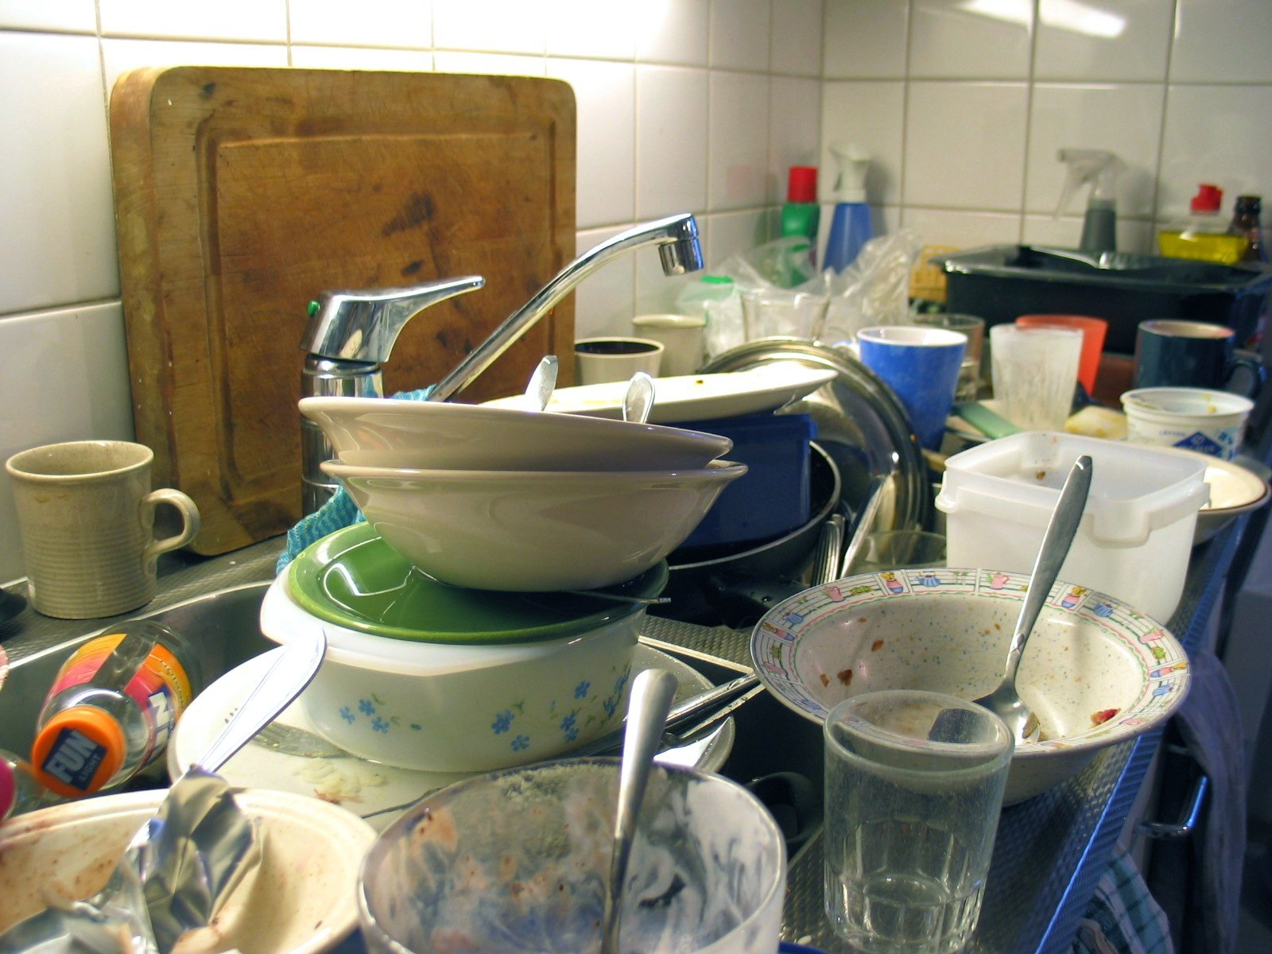

Best Practice 8 – Software Patterns
Take software patterns seriously.
Familiarize yourself with them and what their goal/purpose is.
Learn to recognize the pattern in code you have written or are reviewing.
Avoid the Kitchen Sink and Stream of Consciousness Patterns.

Slide 22
Best Practice 9 – OS is irrelevant
If you are coding Java to take advantage of unique features in Linux, MacOS, or Windows than you are doing it wrong.
Write code for users and the Java Virtual Machine.
Consider running unit, integration, and functional tests in more than one OS.

Slide 23
Best Practice 10 – IDE & Build Systems
Use the IDE that you perceive will make you the most productive.
Never use an IDE’s custom internal build system.
Use Maven or use Gradle.
In a pinch use Ant.
The long-term maintenance of software will likely involve many developers over time.
Do not require a specific IDE for software to build, use a build tool.

Slide 24

Best Practice Bonus - Consistency
Here is a question I frequently ask developers and managers about their work place.
Does the organization have a manual of practices that must be followed?
“No” is the most common response.
Results in a “Get it to work” at any cost atmosphere.
What do you do if you work for an organization that does not have such a manual?
I hope that you write your own and share it. .

Slide 25
Best Practice Double Bonus – static anything
As I understood it when I moved from C to C++:
Static variables and methods exist to avoid the overhead of OOP
They exist to deal with potential performance issues
The performance issues in C++ are not the same as for Java
Therefore there are only 4 valid reason for static:
Methods of such a general nature they reveal nothing of their caller
Math.pow(), etc
Variables used as a messenger between instances of a class.
Singletons
Functional programming
Shared constants

Slide 26
Best Practice Super Double Bonus – i18n
We live on a planet with billions of people who might want to buy your stuff
Only problem is that there are, according to the internet, ~7500 languages still in use
Always use Internationalization even if the UI is just in your native language
One day you will want to sell to Italians, Mongolians or Ukrainians

Slide 27
Thank -you
One last piece of advice:
Write your code as if it will be running till the end of time.
You will never work on it again, only others.
Assume that you will be hired at your next job by your former work mate who had to look after your code at a previous job.

